Slide 1
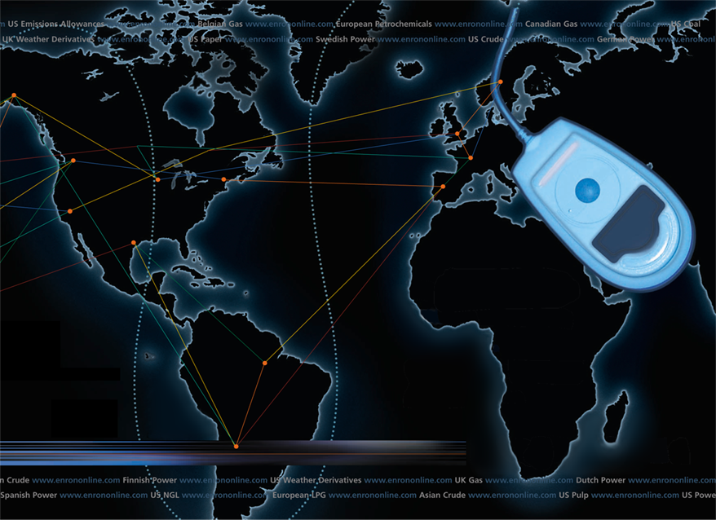
Putting the Energy into e-commerce
EnronOnline
TM
TM

Slide 2
Benefits of EnronOnline
Free of charge
Real-Time Pricing Information
Access to complementary markets and product information
Simple access via the Internet
Easy to use
Fast and Secure Execution
Enron’s Best Prices

Slide 3
EnronOnline Product Type Launch Schedule
    November 1999 US Natural Gas
    Canadian Natural Gas
    December 1999 Coal
    Nordic Power
    Plastics
    Pulp & Paper
    US Power
    January 2000 Continental European Power
    Continental European Gas
    Emissions
    LPG
    Oil & Refined Products
    Petrochemicals
    UK Gas
    UK Power
    Weather
    February 2000 EnBank Virtual Storage Auction (UK)
    March 2000 Credit Derivatives
    Enron Emissions Auctions (US)
    Australian Power
    Summer 2000 Bandwidth
    European Coal

Slide 4
EnronOnline Statistics
Total Life to Date Transactions > 86,000
Currently > 45 % of Enron’s Transactions
Average Daily Transactions > 1,200
Life to Date Notional Value of Transactions > $33 billion
Daily Notional Value Approximately $600 Million
Currently > 32% of Enron’s Notional Volume
Number of Products Offered - Approximately 650
Number of Currencies Traded in = 11
Development Time Approximately 7 Months
Announcement Date October 26, 1999
Launch Date November 29, 1999

Slide 5
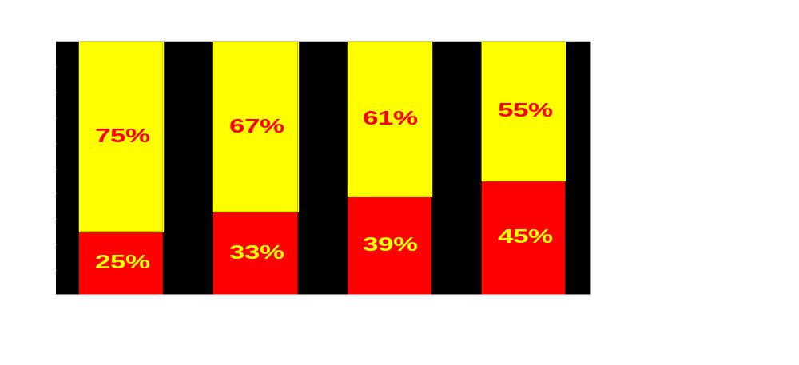
Utilization of EnronOnline
(% of Transactions)
Traditional Channels
EnronOnline

Slide 6
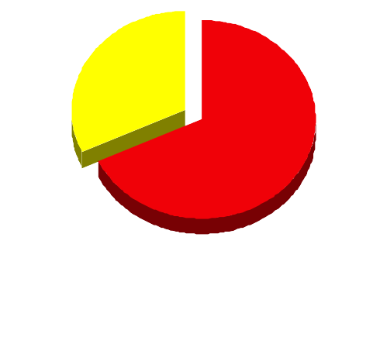
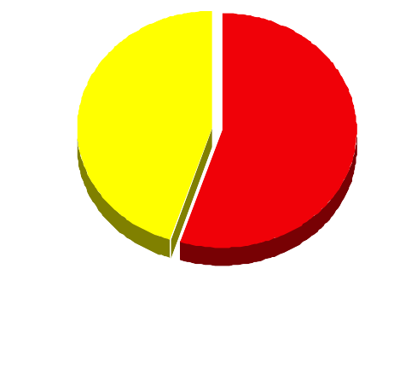
EnronOnline Versus Traditional Channels
(Currently)
Volume
Transactions
32%
45%
55%
68%
EnronOnline
Traditional Channels

Slide 7

Transactions via EnronOnline
(Weekly)

Slide 8
eCommerce Business Comparison
Value of Goods*
Value of Goods
(Millions)
Business To Consumer (B2C)
eBay
Amazon.com
Dell.com
$ 2,650
1,600
10,190
1999 Data*
Business To Business (B2B)
FreeMarkets
Cisco
Intel
Altrade
$ 1,400
9,480
10,500
12,000
2000 Est.**
EnronOnline
> $ 40,000
* Est. 1999 Annual Results
** Annualized Based on Results to Date

Slide 9
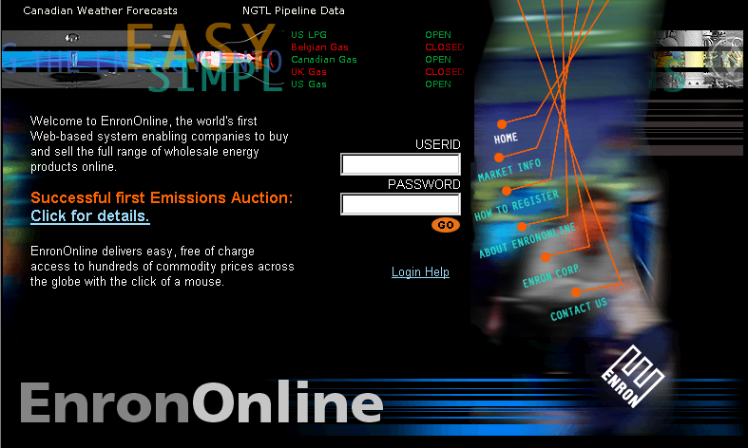
www.EnronOnline.com
New User
*******

Slide 10
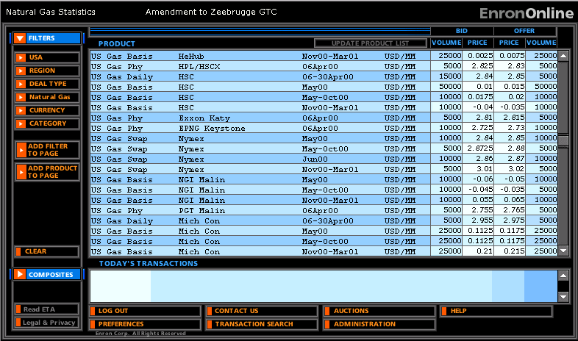
Quotes Page

Slide 11
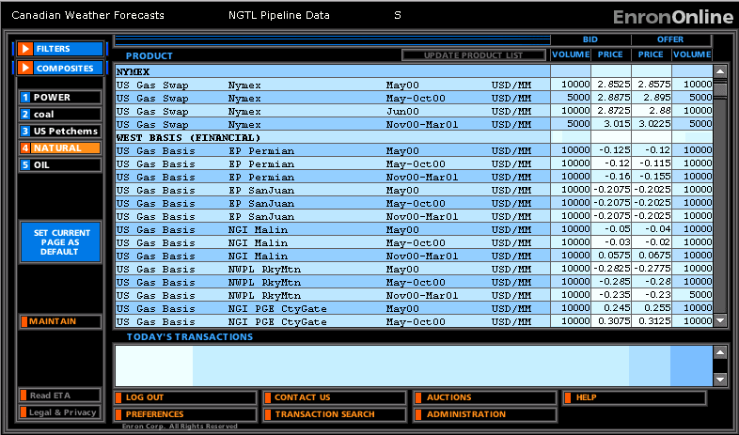
Composite Page

Slide 12
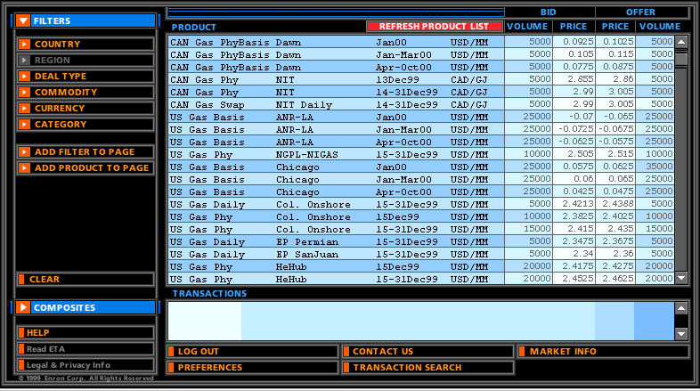
Successful Transaction

Slide 13
Contact Us
If you have questions or problems regarding registration or using EnronOnline:
Call us:
The Americas: All Other Regions:
+1 (713) 853-4357 (HELP) +44 (0)20 7783 7783
Write us:
EnronOnline EnronOnline
P.O. Box 4656 Enron House
1400 Smith Street P.O.Box 29173
Houston, TX 77002 London SW1X 7WB
UK
E-Mail us at help@enrononline.com

Slide 14


